Slide 1
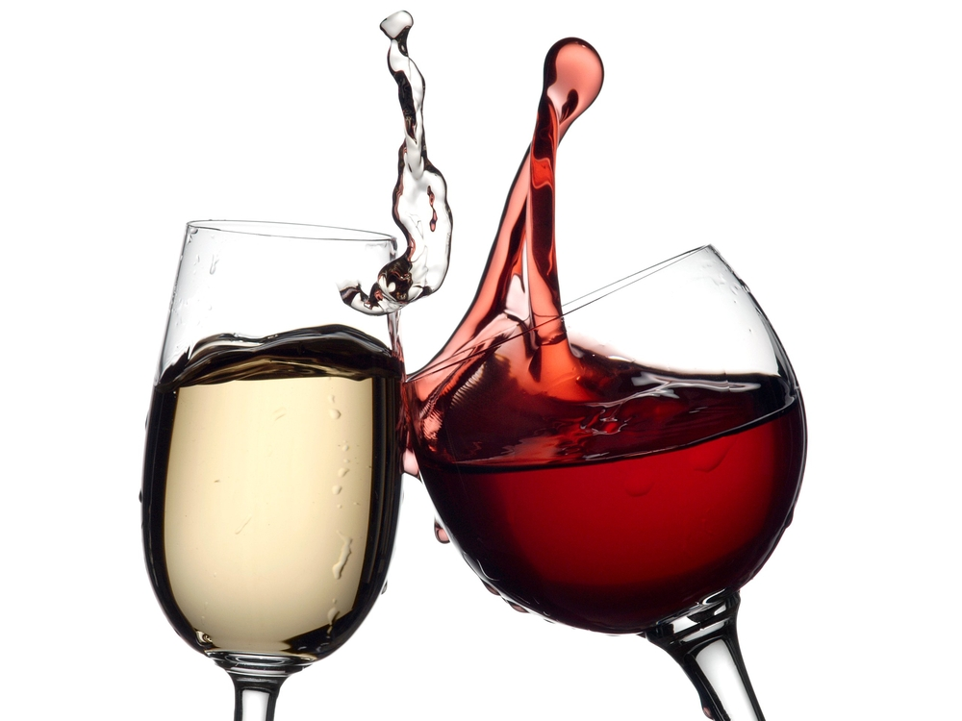

Wine Quality Analysis and Prediction
By
Santosh Omprakash

Slide 2
Contents
Problem statement
Proposal
Data preprocessing
Exploratory Data Analysis
Model Selection and Evaluation
Results
Conclusion

Slide 3

Problem Statement
Wine consumption is consistently increasing over the years
As per Silicon Valley Bank reports, wine tops the e-commerce trend in Alcohol in 2020
Many varieties of wine are available, and quality is determined by balance in its chemicals, intensity and finish
Wine quality is important to preserve human health
Wine quality is determined by sensory or physiochemical tests
The testing process involves lot of steps and manual intervention is needed

Slide 4
Proposal
Wine quality can be determined using Machine Learning Algorithms
The factors that affect quality of wine are analyzed
Wine data is evaluated in various model and best model is selected
Wine manufacturers can use prediction from model to improve wine quality

Slide 5
Data Preprocessing
Wine dataset was selected from Kaggle
It has 13 variables – Wine type, fixed acidity, volatile acidity, citric acid, residual sugar, chlorides, free sulfur dioxide, total sulfur dioxide, density, pH, sulphates, alcohol and quality
Target variable is ‘Quality’
Data had some null values, and they were cleaned to replace them with zeros
Total number of records are 6497

Slide 6
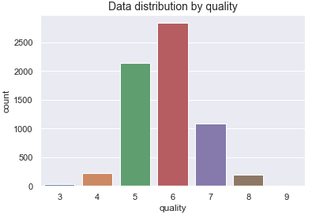
Exploratory Data Analysis (EDA)
The values in ‘Quality’ variable ranges from 3 to 9. 9 is the best score
Dataset is imbalanced with more data for 5, 6 and 7 records

Slide 7
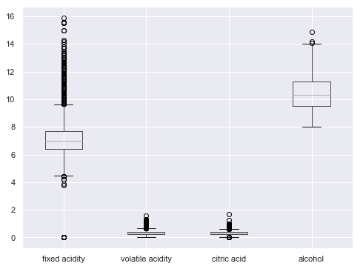
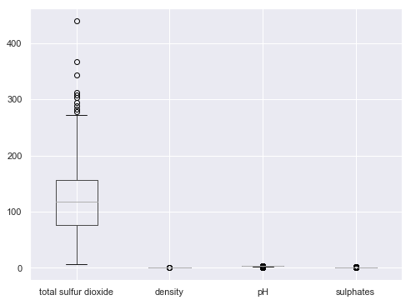
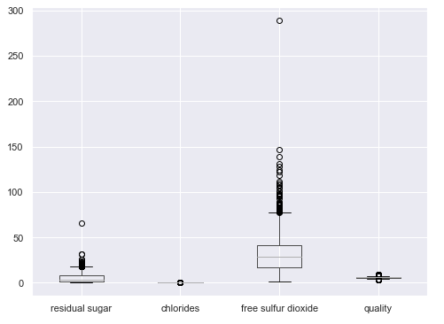
EDA
Box plot for each variable is shown
It shows the presence of outliers in ‘fixed acidity’, ‘free sulfur dioxide’ and ‘total sulfur dioxide’
Outliers were removed from the three variable by calculating minimum and maximum values

Slide 8
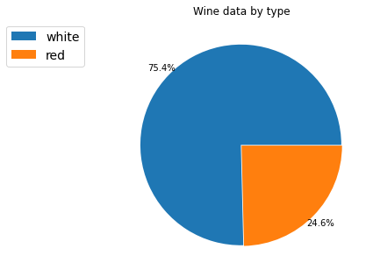
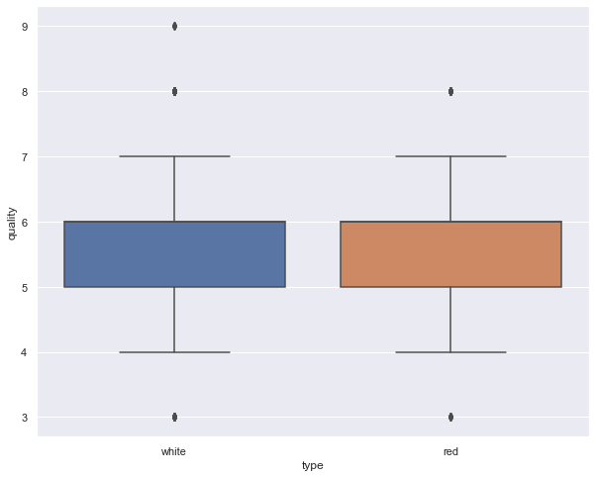
EDA
The pie-chart show records by wine type – Red and White
Box plot shows values for Red and White wine present in dataset at almost same.
This proves that wine type doesn’t impact the quality of wine

Slide 9
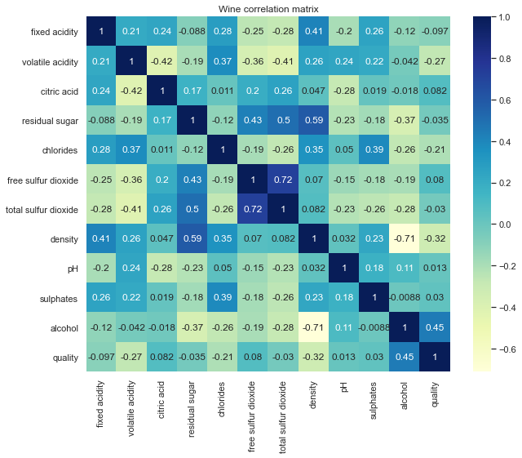
Correlation between features
Quality has positive correlation with Alcohol
It has negative correlation with volatile acidity, density and chlorides
There is almost no correlation with residual sugar, pH

Slide 10
Model selection and Evaluation
Since the dataset is imbalanced, the metric used for models is ROC-AUC (Receiver Operating Characteristic Area Under Curve)
The ‘Quality’ variable is categorized to ‘Average’ and ‘Good’. Values 3 to 5 are considered Average and values 6 to 9 are considered as Good wine
Normalization was done using Standard scaler
Label Encoding was then used to convert the categorical variable
80% of the data was selected for training and 20% for testing

Slide 11
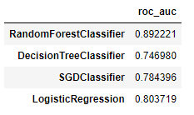
Model selection and Evaluation
Four models were chosen, and the train data was used to determine the score
Random Forest model had the best ROC-AUC score of 89%
It was selected for further tuning

Slide 12
Model selection and Evaluation
For Hyper parameter tuning, Grid Search CV was used for Random Forest model
Parameters like estimators, criterion and max features were selected
The model score increased to 91%

Slide 13
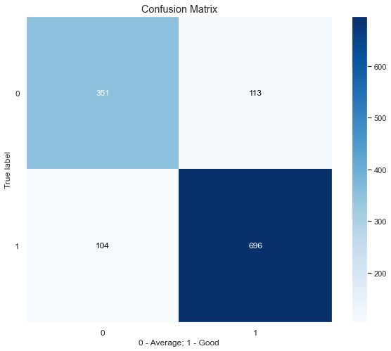
Results
Overall Wine Quality prediction of model is 91%
Confusion matrix of the tuned model shows that True Positive rate is 87% and True negative rate is 75%

Slide 14
Conclusion
Quality of wine was predicted as Average or Good
Random Forest Machine learning model was selected for prediction
Alcohol is the most important feature that determines quality. Other features like Citric Acid, Sulphates are also important.
Volatile Acidity, Chlorides, Sulfur dioxide should be in less percentage for good quality wine

Slide 15
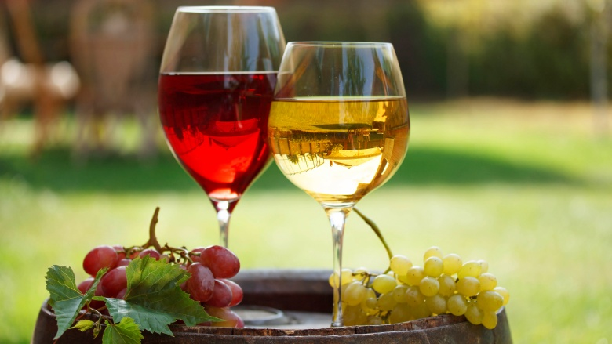
Thank you

